Slide 1

5CS019 - Object Oriented programming and design (OODP)
Class and Object
Tutorial 04
Herald College, University of Wolverhampton

Slide 2
Recap…
Looping in JAVA
FOR loop
While Loop
DO-WHILE loop
Arrays in Java
Enhanced FOR loop
Looping and Arrays combined

Slide 3
Topics Covered Today
Class/ Object
Java Methods
Java class Constructor
Java Access Modifiers
Encapsulation

Slide 4
Class in Java
A class is a collection of objects that have similar characteristics, behaviours, and attributes.
Class is not a real world entity. It is just a template or blueprint or prototype from which objects are created.
Modifiers(public)
Class Keyword (class)
Class Name(Student)

Slide 5
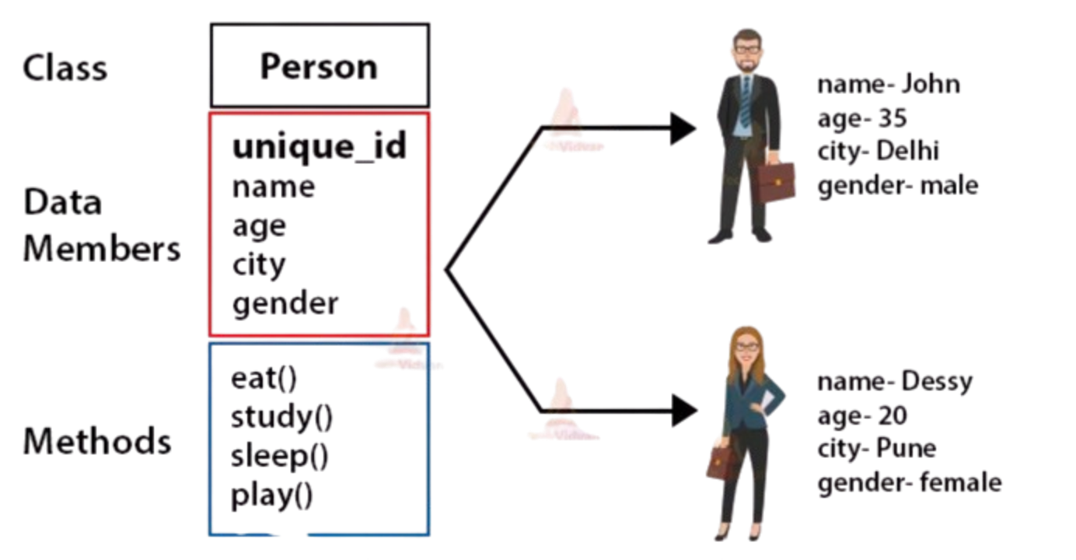

Slide 6
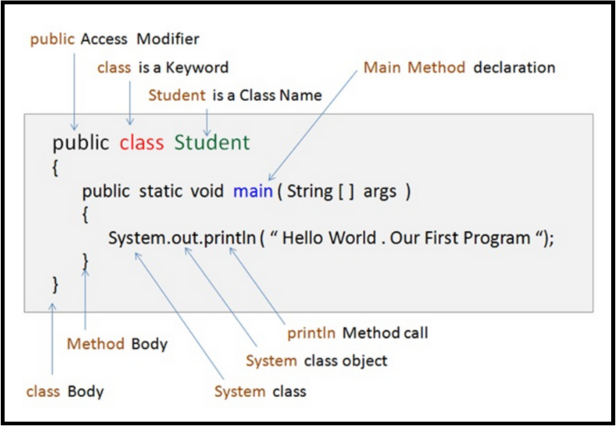
Class declaration in Java

Slide 7
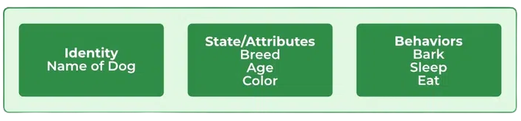
Java Object
An object in Java is a basic unit of Object-Oriented programming and represents real-life entities.
An object consists of :
State: It is represented by attributes of an object.
Behavior: It is represented by the methods of an object.
Identity: It gives a unique name to an object and enables one object to interact with other objects.

Slide 8

Declaring object in Java

Slide 9
Task 1:
Define a class named Car with attributes brand, model, and year.
Task 2:
Create a class named 'Student' with String variable 'name' and integer variable 'roll_no'. Assign the value of roll_no as '2' and that of name as "John" by creating an object of the class Student.

Slide 10
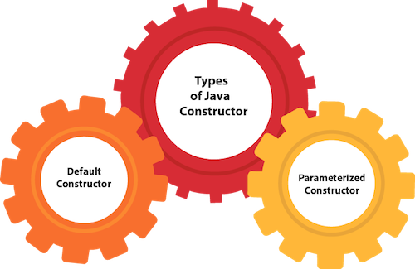
Constructor in Java
A constructor in Java is a special method that is used to
initialize objects.
The constructor is called when an object of a class is created.
It can be used to set initial values for object attributes.

Slide 11
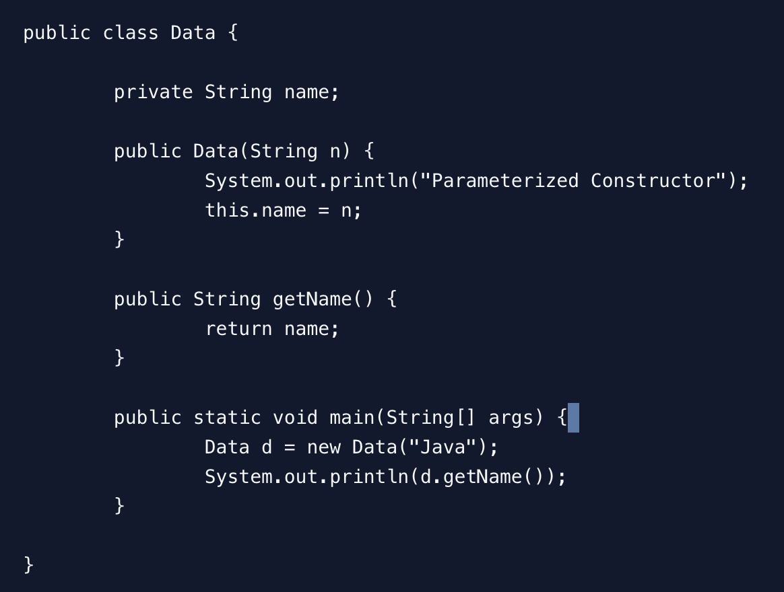
Declaring constructor in Java

Slide 12
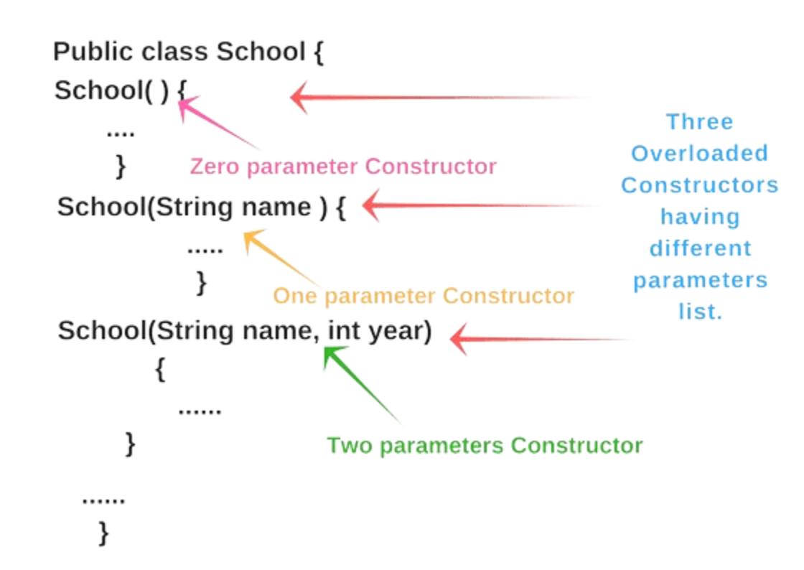
Constructor overloading in Java

Slide 13
Task 3
Write a program to declare a triangle having sides of 3, 4 and 5 units by creating a class named 'Triangle' with constructor having the three sides as its parameters.
Task 4
Implement a no-argument constructor that prints out “User created!” as soon as the instance of the user is created.

Slide 14
Task 5
Create a class named ,”Box” with attributes width, height, and length. Create multiple constructors for handling following object declarations:
For a cube, declare a constructor to take length only.
For a cuboid, declare a constructor to take length, breadth, and height.
For no parameter, declare a no-argument constructor that sets length = 10, breadth = 8, and height = 12.

Slide 15
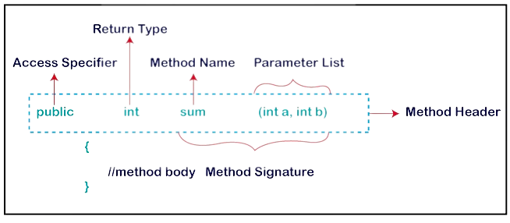
Methods in Java

Slide 16
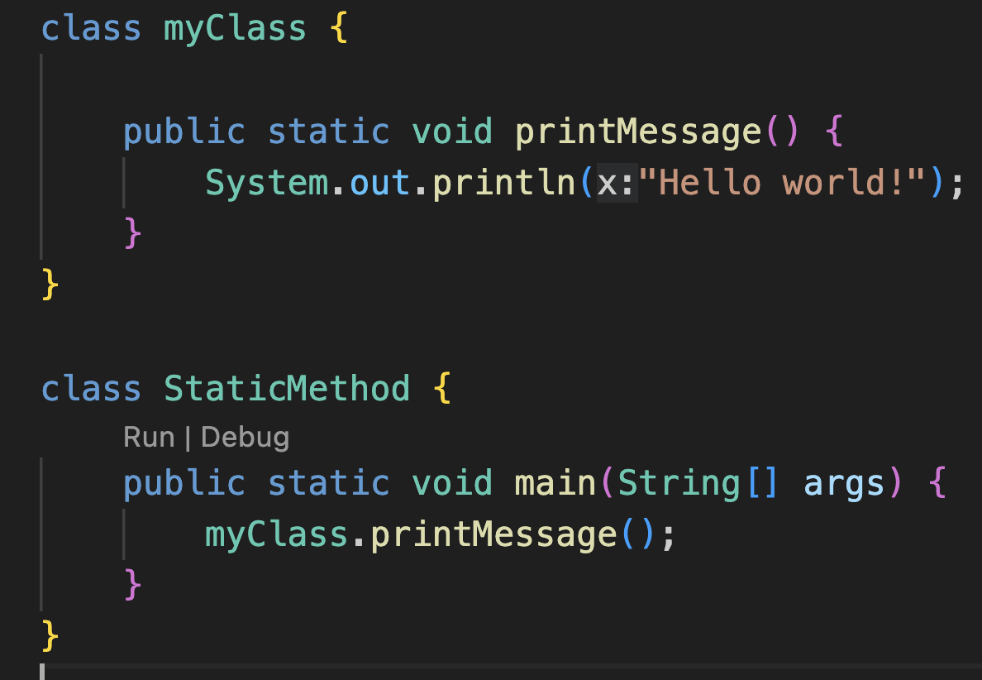
Static method
Static methods are designed in such a way that they can be shared among all objects created using the same class.

Slide 17
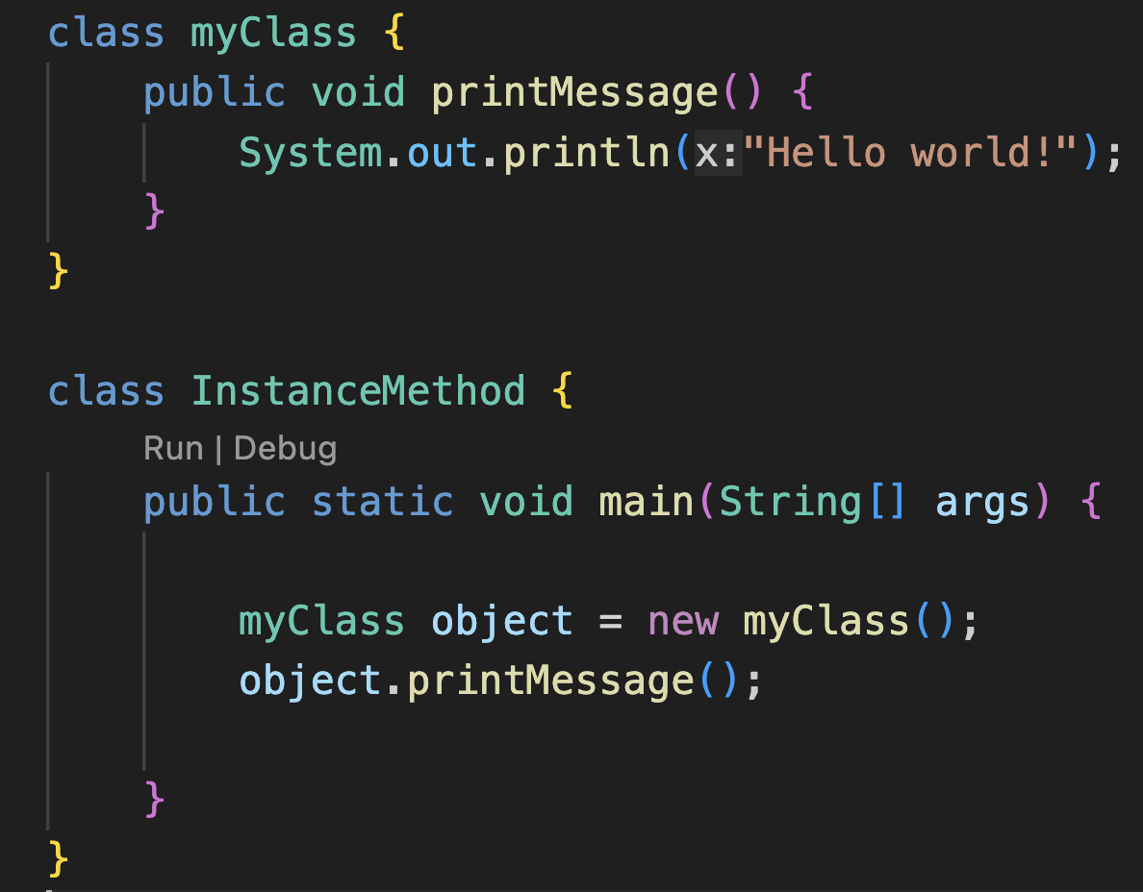
Instance Method
Instance methods is related to an object rather than a class.

Slide 18
Q1. In which case do you prefer using static methods over instance method?
Q2. What is the difference between user-defined and library methods in Java?

Slide 19
Task 6
Create a class named 'Student' with String variable 'name' and integer variable 'roll_no'. Assign the value of roll_no as '2' and that of name as "John" by creating an object of the class Student
Task 7
Print the average of three numbers entered by user by creating a class named 'Average' having a method to calculate and print the average.

Slide 20
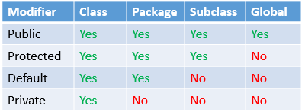
Access Modifiers
Java specifies the accessibility or scope of a variable, or methods.

Slide 21
Task 8
Declare a class Employee with attributes id(default), name(public), experience (public), department(public), age(private), and salary (private). Create a constructor to assign the value of the attributes.
Try accessing the attributes and printing its values. What is the result?

Slide 22
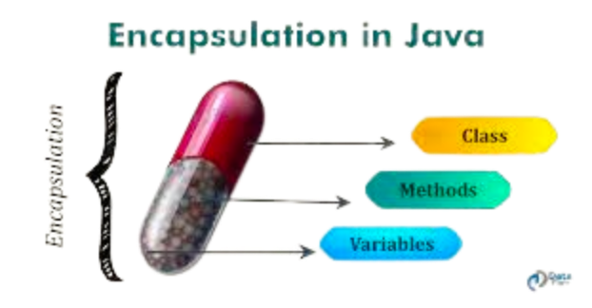
Encapsulation
Encapsulation is a mechanism to bundle the data and code acting on the data together as a single unit.
Provide a Public setter and getter method to modify and view the values of the variables.

Slide 23
Getters and Setters
Setter: While Setter sets or updates the value (mutators).
Getter: Getter returns the value (accessors), it returns the value of data type int, String, double, float, etc.

Slide 24
Q3. How can encapsulation be implemented in Java? What is the use of getter and setter methods?
Task 9
Implement getters to print the attributes of the class Employee (refer to Task 8).

